Slide 1
WORLD UNIVERSITY RANKINGS
ผศ.ดร.ใกล้รุ่ง สามารถ
ผู้ช่วยอธิการบดีฝ่ายวิเคราะห์ข้อมูล
มหาวิทยาลัยสงขลานครินทร์

Slide 2
Why are university rankings so important?
  Reflect quality of universities
  Benchmark with peers on different aspects
  Lead to universities’ development plan

Slide 3
World University Rankings: PSU
U-Multirank
THE
QS

Slide 4




Slide 5
QS World University Rankings 2020

Slide 6
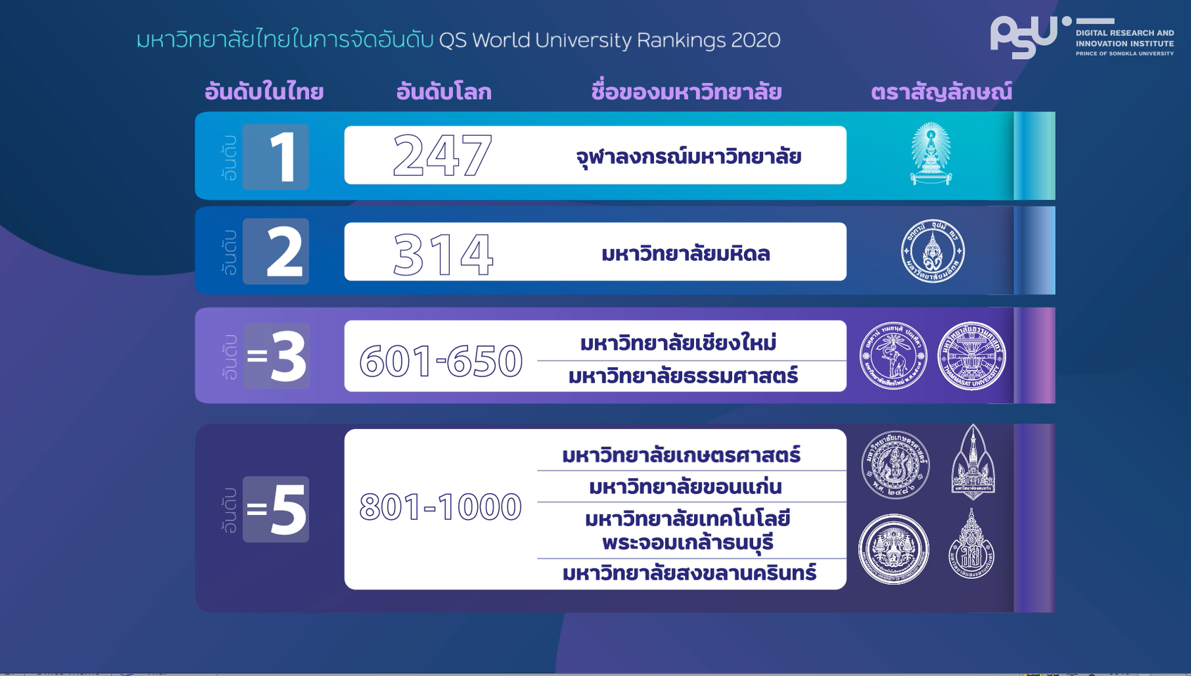

Slide 7
QS Rankings 2020: PSU

Slide 8
QS Rankings 2020: PSU
Academic Reputation - surveys scholars around the world to name universities that they believe are the best in their discipline (research and teaching).

Slide 9
QS Rankings 2020: PSU
Employer Reputation - asks employers to identify those institutions from which they source the most competent, innovative, effective graduates.

Slide 10
QS Rankings 2020: PSU
Citations/Faculty- journal articles, article reviews, conference proceedings, books and book chapters article in press, business article published over five years (2013-2017) indexed in Scopus. Citations from 2013 to 2018 are collected and divided by number of faculty members.

Slide 11
QS Rankings 2020: PSU
Faculty Student- Faculty/student Ratio

Slide 12
QS Rankings 2020: PSU
International Faculty – Proportion of international faculty
International Students– Proportion of international students

Slide 13
QS Asia Rankings 2019

Slide 14
QS Asia Rankings: PSU

Slide 15
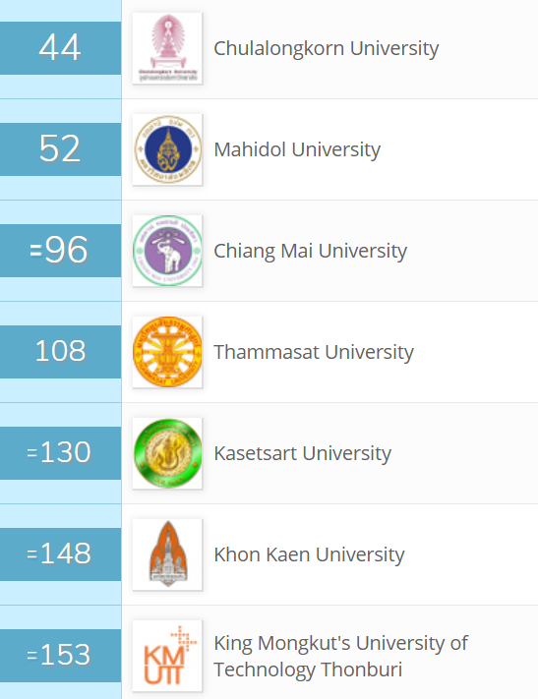
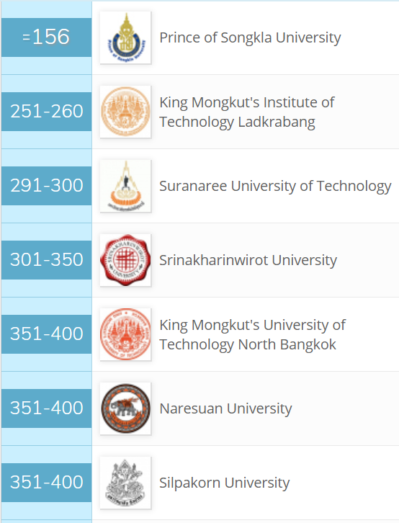
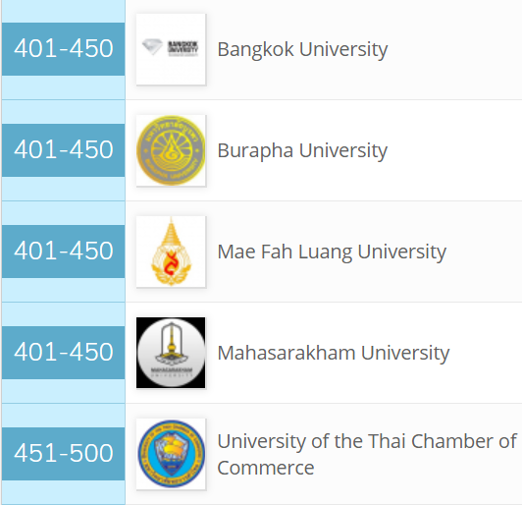
QS Asia Rankings: THAILAND

Slide 16
THE World University Rankings 2019

Slide 17
THE: THAILAND

Slide 18
THE Rankings: PSU
Reputation - survey scholars (2017-2018) around the world to name at most 15 universities that they believe are the best in their discipline (research and teaching)

Slide 19
THE Rankings: PSU
Paper per academic and research staff - number of publications published in 2013-2017 indexed by Scopus per scholar

Slide 20
THE Rankings: PSU
Citations - journal articles, article reviews, conference proceedings, books and book chapters published over five years indexed by Scopus. Citations from 2013 to 2018 are collected.

Slide 21
THE Rankings: ASEAN

Slide 22
THE: Exclusions
Do not teach undergraduates
Research output amounted to fewer than 1,000 relevant publications between 2013 and 2017 (with a minimum of 150 a year)
80% or more of research output is exclusively in one of THE’s 11 subject areas.

Slide 23
U-MULTIRANK 2019

Slide 24
U-MULTIRANK
ดำเนินการโดยนักวิชาการจากสถาบันการศึกษาต่าง ๆ ในทวีปยุโรป
ประเมินมหาวิทยาลัยต่าง ๆ โดยแยกเป็นสาขาและเปรียบเทียบมหาวิทยาลัยต่าง ๆ ที่เข้าร่วมในสาขาเดียวกัน
ประเมินมหาวิทยาลัยจากผลงานใน 5 ด้าน คือ Teaching & Learning , Research, Knowledge Transfer, International Orientation และ Regional Engagement

Slide 25
Teaching & Learning

Slide 26
Research

Slide 27
Knowledge Transfer

Slide 28
International Orientation

Slide 29
Regional Engagement

Slide 30
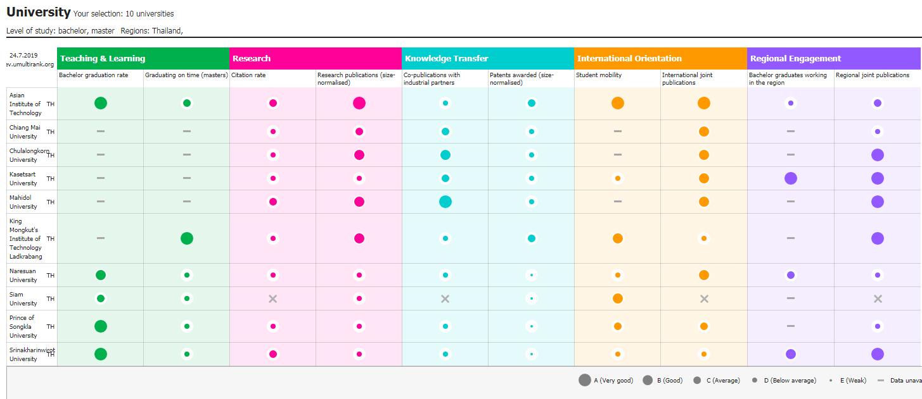
U-Multirank: THAILAND
Source: www.umultirank.org

Slide 31
Siam University

Slide 32
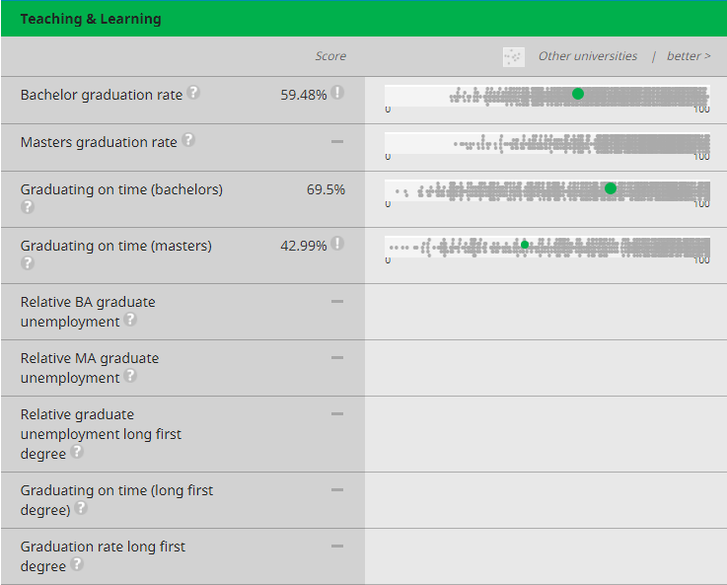
Teaching & Learning

Slide 33
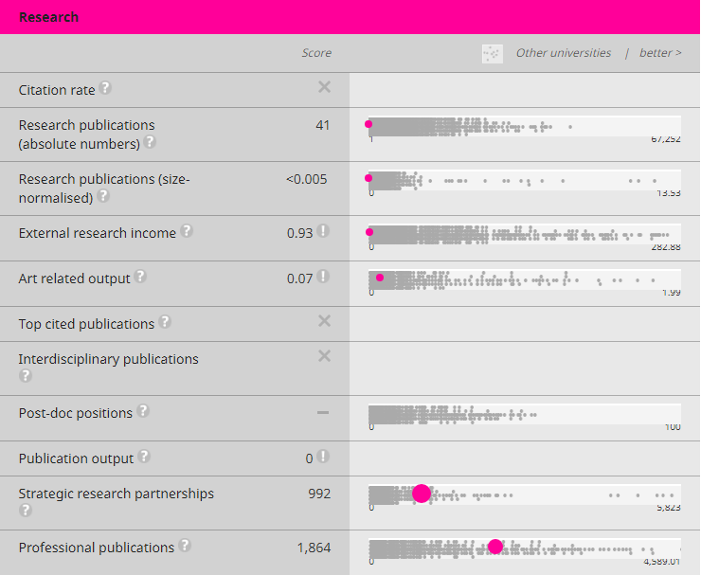
Research

Slide 34
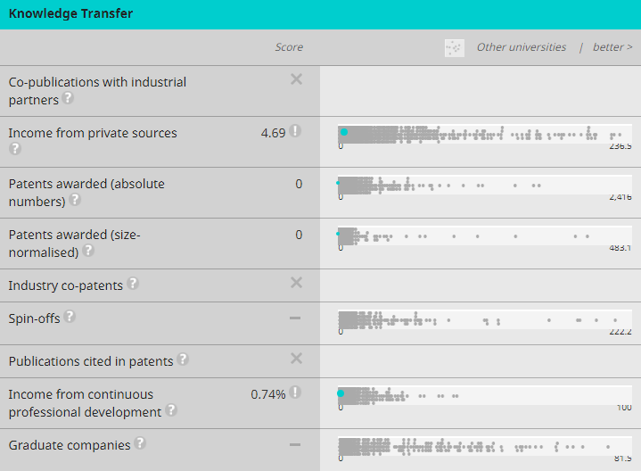
Knowledge Transfer

Slide 35
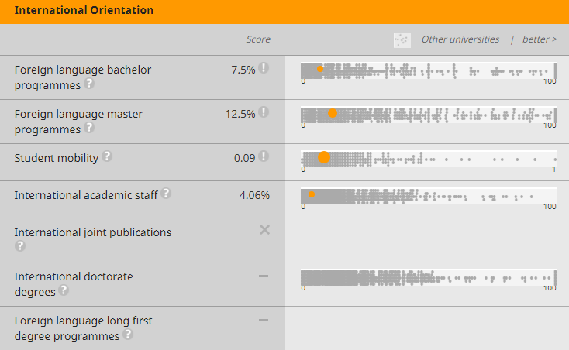
International Orientation

Slide 36
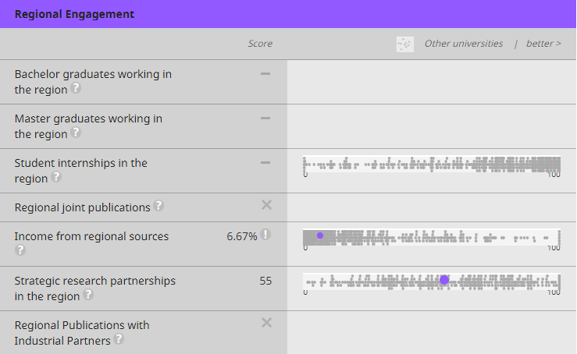
Regional Engagement

